Slide 1
Giving Effective Feedback and Coaching Team Members
Alex Cann

Slide 2
Overview
Reflection on your current practice
What does effective feedback look like?
A positive structure to guide the feedback conversation
Useful tips and techniques for delivering feedback
Coaching model and suggested questions
An opportunity to try these out
Questions

Slide 3
3 Questions…..
How often do you give feedback to your team?
How do they feel about receiving feedback?
How effective is your feedback?

Slide 4
What is effective feedback and what does it look like?
Developmental
Motivational
https://a4m.co/topics/L3utfiaqQX6DSG8U.html

Slide 5
Motivational and Developmental
Motivational
Helps to build confidence
Developmental
Helps to build competence

Slide 6
The PRISM Model
TUI Leadership Essentials

Slide 7
Useful Feedback Tips
Send feedback questions ahead of time
Start using a log/feedback book
Mention specific behaviours
When you do this….. this happens…
Start with motivational feedback then use ‘and’ to give developmental
‘and if you had done this……’
Remember to ASK rather than TELL by using targeted questions
Use feedback sessions to build relationships, strengthen channels of communication, improve performance, motivate your team and provide better ‘buy in’ to solutions
Always aim for a ‘WIN/WIN’ result

Slide 8
180° Feedback

Slide 9
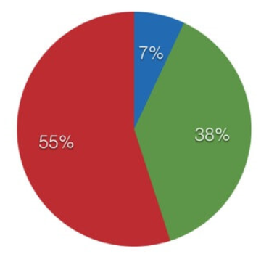
3 Elements of Communication

Slide 10
Coaching – The GROW Model
Goal
Reality
Options
Way forward

Slide 11
Goal Setting
Writing down goals makes you 45% more likely to achieve them
Sharing them publicly makes you 85% more likely to achieve them

Slide 12
Objectives Tracker

Slide 13
Useful Coaching Tips
Aim for a 20/80 split where you act as a facilitator, helping your team members to draw conclusions for themselves and select the best options.
Remember that, as a manager, you may well have expert knowledge to offer; use this to guide your team members to make the best decisions.
Ensure that goals and objectives are SMART
Ask good questions and listen effectively (active listening skills)
Allow periods of silence as they provide valuable thinking/‘sink in’ time

Slide 14
Remember….
“Coaching is unlocking a person’s potential to maximise their own performance. It is helping them to learn rather than teaching them”
John Whitmore

Slide 15
Giving Effective Feedback and Coaching Team Members
Alex Cann
alex.cann@experienceenglish.com

